Slide 1
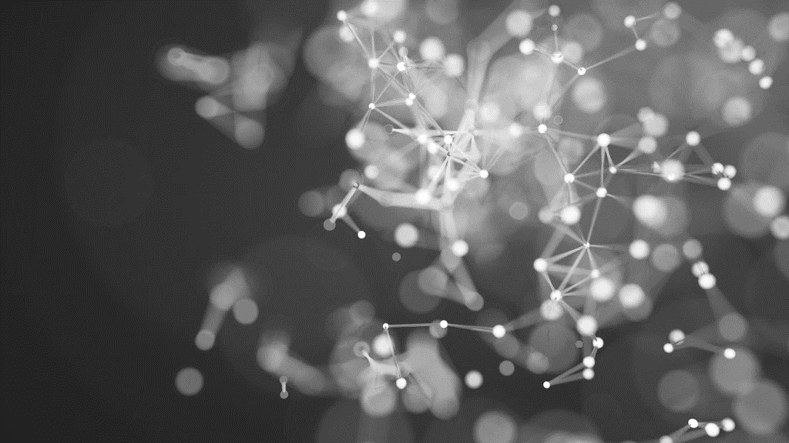
Machine learning
Presentation
Mercea Alex-Ovidiu

Slide 2
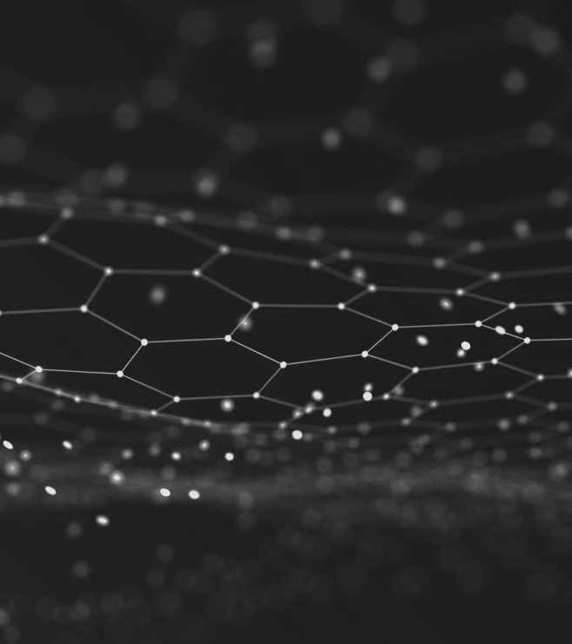
Summary
INTRODUCTION
SUPERVISED LEARNING
UNSUPERVISED LEARNING
DEEP LEARNING
CLOSING

Slide 3
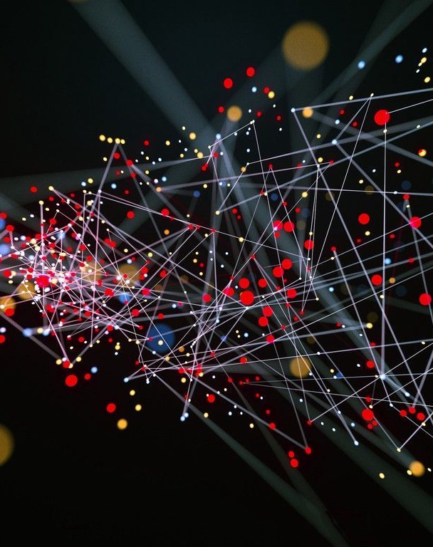
INTRODUCTION
What is Machine Learning?
Arthur Samuel described it as: "the field of study that gives computers the ability to learn without being explicitly programmed.“
Proper Definition:
Machine learning (ML) is the study of computer algorithms that improve automatically through experience and by the use of data.

Slide 4
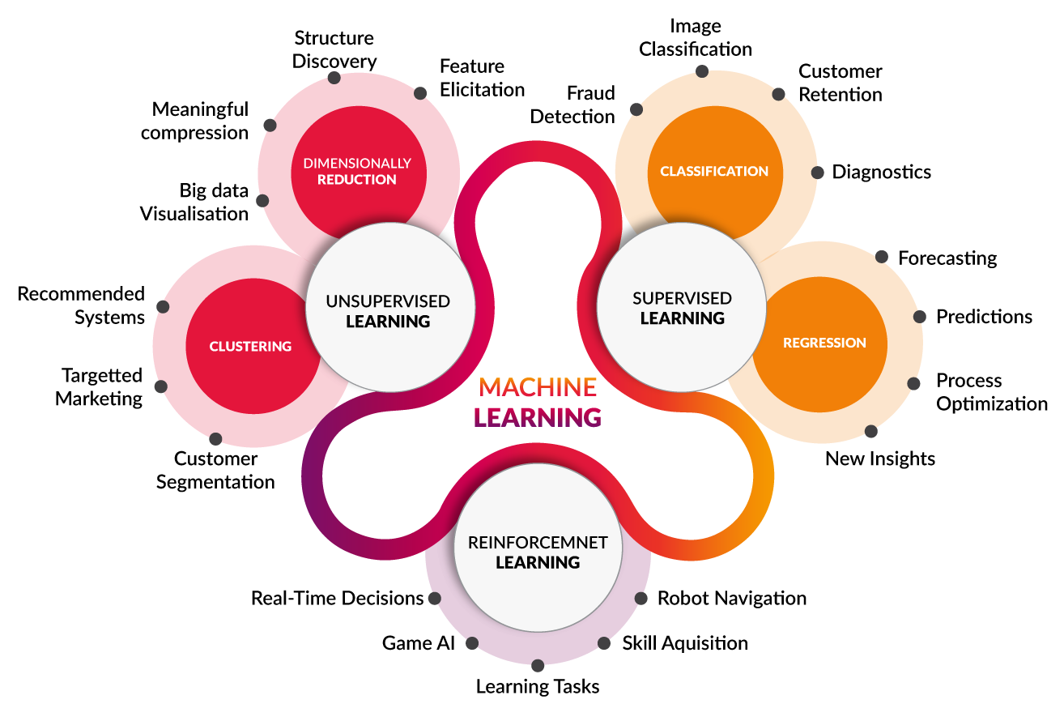
INTRODUCTION
Main Branches of Machine Learning
There are three machine learning archetypes:
Unsupervised Machine Learning
Supervised Machine Learning
Reinforcement Machine Learning

Slide 5
Supervised Learning
What is Supervised Learning?
For every example in the data there is always a predefined outcome.
Models the relations between a set of descriptive features and a target (Fits data to a function)
There are 2 groups of problems:
Classification
Regression

Slide 6
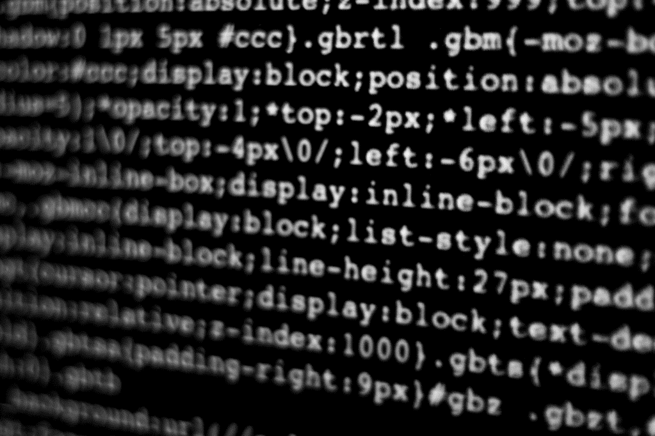
Supervised Learning
regression

Slide 7
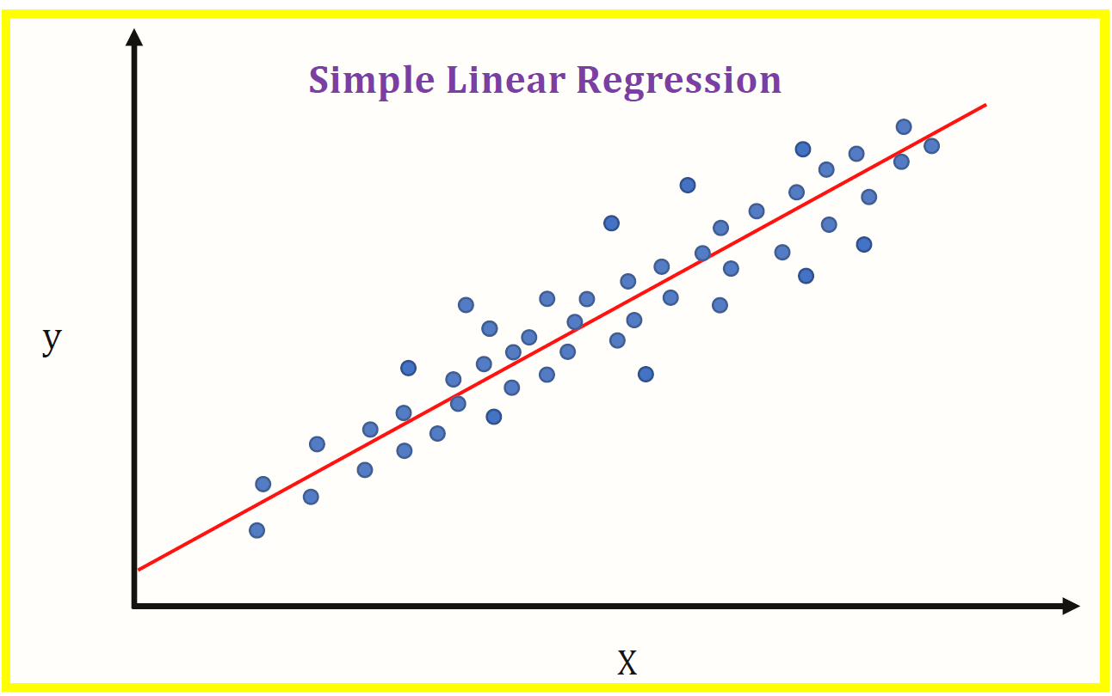
Linear regression
Simple linear regression

Slide 8
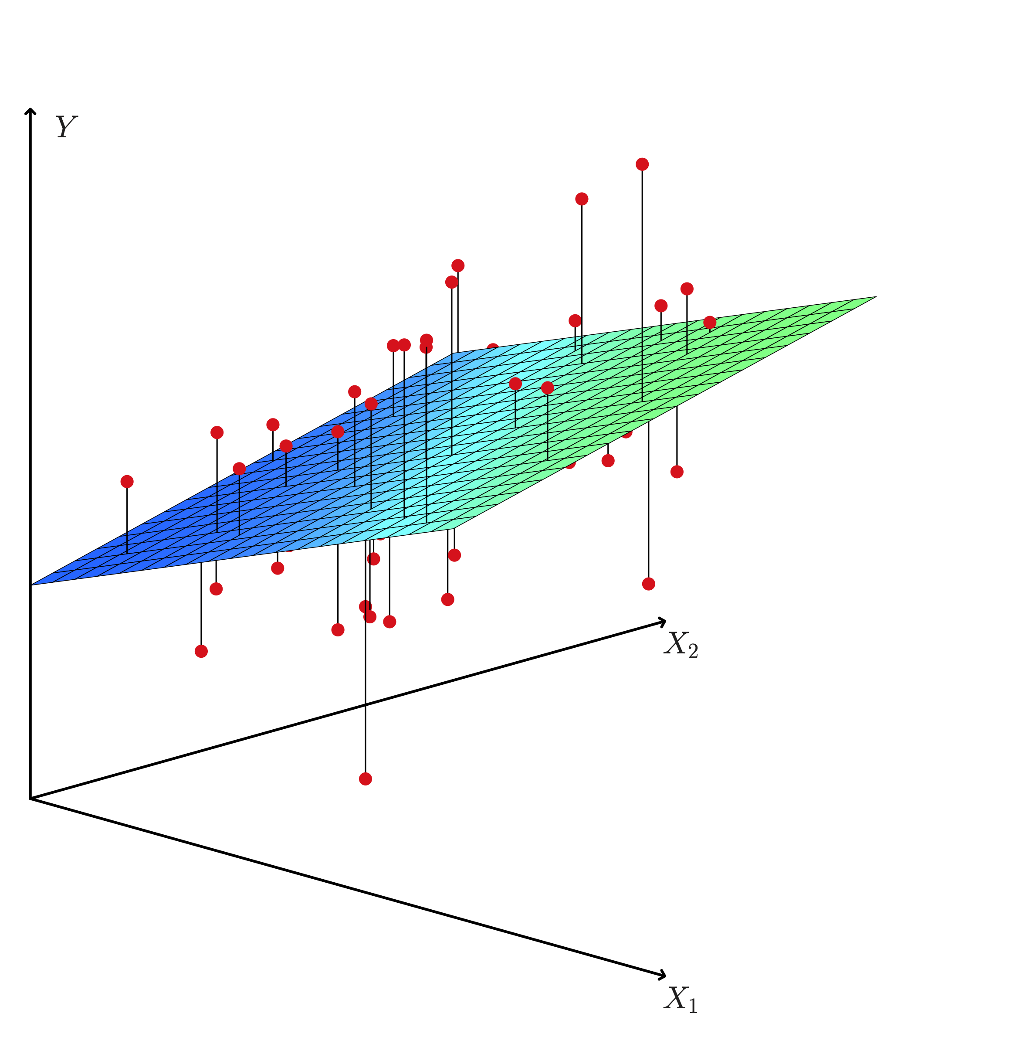
Linear Regression
Multiple Linear regression

Slide 9
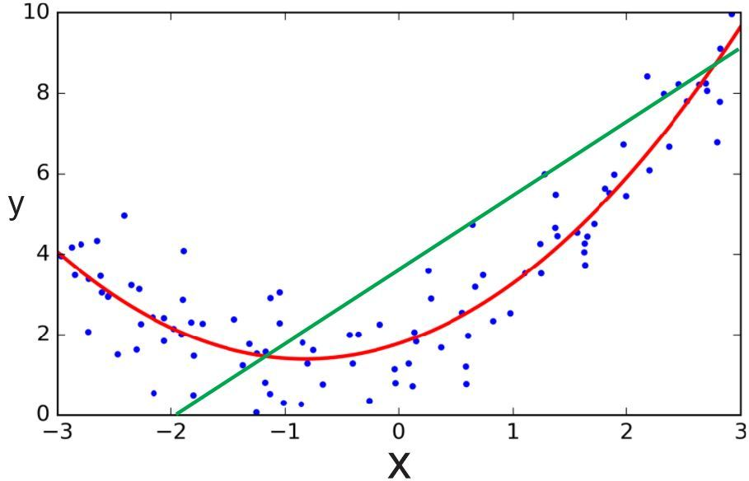
Polynomial regression
Regression

Slide 10

Support vector regression
regression

Slide 11
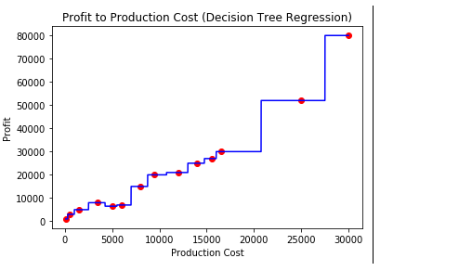
Decision tree Regression
regression

Slide 12
Supervised Learning
Classification

Slide 13
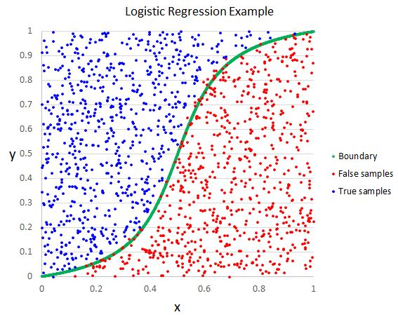
Logistic regression
classification

Slide 14
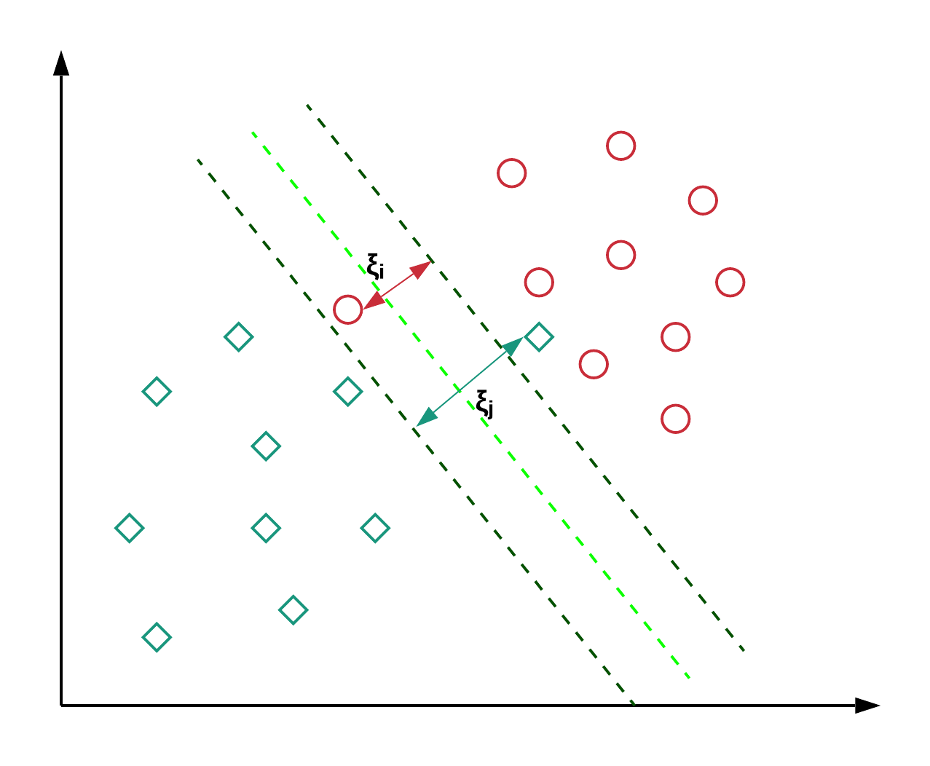
Support vector machines
classification

Slide 15
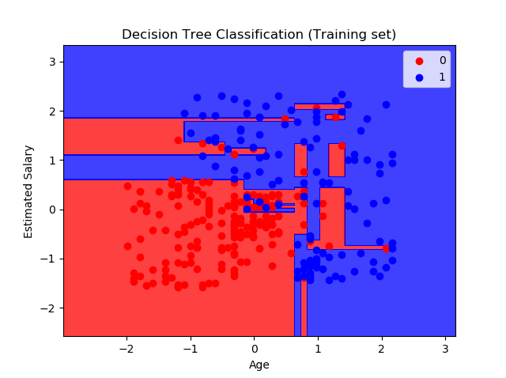
Decision tree classification
classification

Slide 16
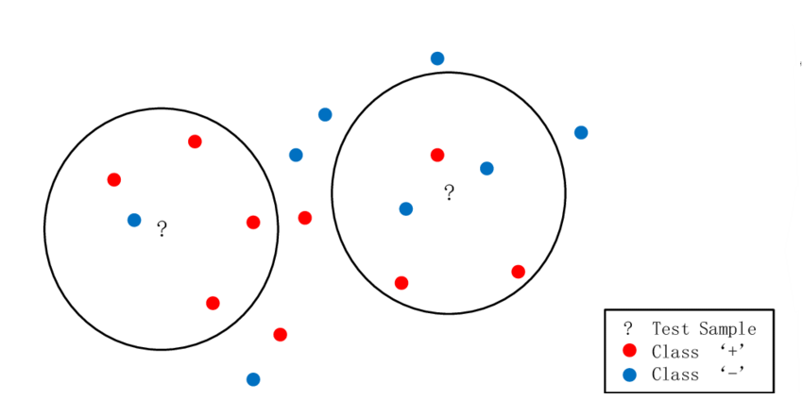
K-Nearest Neighbors
classification

Slide 17
unsupervised Learning
What is Unsupervised Learning?
Unsupervised learning, also known as unsupervised machine learning, uses machine learning algorithms to analyze and cluster unlabeled datasets.
Main applications:
Clustering
Anomaly detection
Association mining
Latent variable models

Slide 18
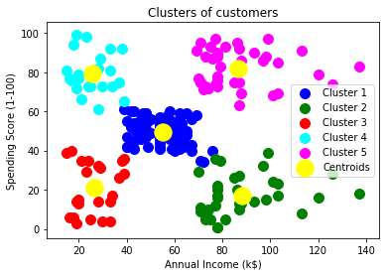
K-Means clustering
clustering

Slide 19
Deep learning
CNN and ANN

Slide 20
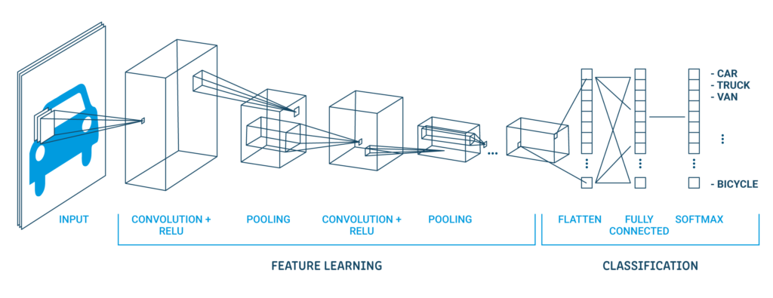
Convolutional neural networks

Slide 21
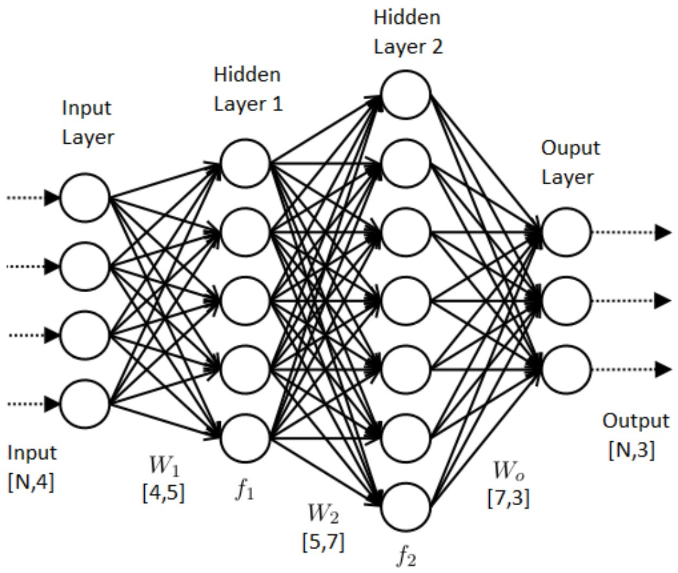
Artificial neural networks

Slide 22
conclusion
Machine Learning can be Supervised or Unsupervised. If you have lesser amount of data and clearly labelled data for training, opt for Supervised Learning. Unsupervised Learning would generally give better performance and results for large datasets. If you have a huge dataset easily available, the best approach is deep learning techniques.

Slide 23
THANK YOU
Mercea Alex-Ovidiu

